Slide 1
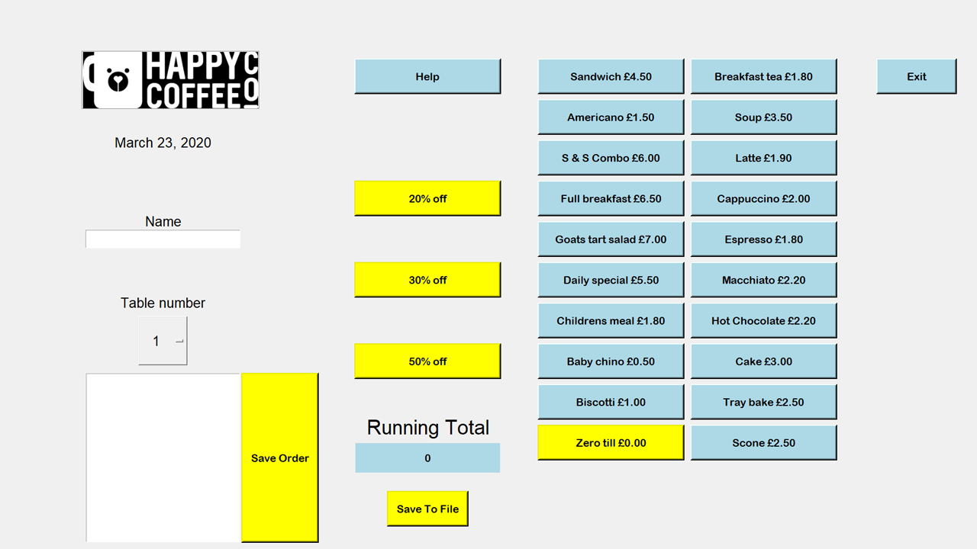
These buttons will take a percentage off the running total.
This is the button you clicked and will display the help, duh.
This button will exit the program whenever it is clicked.
The current date will be displayed here and will change.
You will need to enter in the name of the person that you will be making the table for.
These buttons are all of the items that you can select which will add to the running total.
This will have a dropdown and will display all the tables.
The running total will be displayed here and will update depending on what is clicked.
This section is where the orders will be displayed after the save order button is clicked.
Whenever you have entered in the name, chose the table number and have added all the correct items. Then you can save the order to the box by clicking this button.
Clicking this button will save all of the current order information that is saved in the list. It will be saved with the current date and will append all of the orders for the day.

